Slide 1
DATA ANALYSIS PORTFOLIO
By:
Srihitha Donta

Slide 2
Table of contents
Professional background
Data analytics process
Instagram user analytics
Operation and metric analytics
Hiring process analytics
IMDB movie analysis
Bank loan case study
Impact of car features
ABC call volume trend

Slide 3
Professional background

Slide 4
Professional background
I am currently in the final year of my B.Tech in Computer Science, and my technical skills encompass Python, SQL, C language, Power BI, and Excel. Throughout my academic journey, I have successfully undertaken projects in machine learning, data analysis, and business analytics, showcasing my practical application of theoretical knowledge. I have also delved into case studies to deepen my understanding of real-world applications. My interests lie in the intersection of analytics, finance, and strategy creation. I am passionate about deriving meaningful insights from data and leveraging analytical tools to formulate strategic solutions.

Slide 5
Data analysis

Slide 6
Data analysis process
Data analysis is the systematic examination and interpretation of raw data to extract meaningful insights, trends, and patterns. It involves the application of various techniques and tools to uncover valuable information, enabling informed decision-making and problem-solving. Data analysis plays a pivotal role across diverse fields, from business and finance to healthcare and scientific research, empowering professionals to derive actionable conclusions from complex datasets.

Slide 7
We use Data Analytics in everyday life without even knowing it. For Ex : Going to a market to buy something .
Plan
We first decide which things I need before going to market . Is it a shirt , jeans , footwear etc.
Prepare
Next I need to check how much I am willing to spend and how to get that money.
Process
Then I need to check how much I want from the data. Like if I am going to buy footwear what do I want - slippers / shoes / sandals etc.
Analyse
You obviously won't buy things which are out of trend, Also you need to check does the jeans which you have and the colour of t-shirt you want to buy, will it make a good combination.
Share
Now you communicate your idea to the shopkeeper to find the best suitable fit for you.
Act
Then you finally buy it!

Slide 8
EX2:
To check the weather of a place during a particular month of the year so as to take
necessary precautions.
Plan
We decide what are the things required to predict or understand the
weather.
Prepare
Collecting the previous data of weather conditions at that place.
Process
Checking what we want to find out from the data like rainfall, average
temperature etc.
Analyse
Finding the trends or pattern from the data like what is likely the weather to
be during this particular month.
Share
Communicating the idea to friends or family members to select the necessary
equipment for that month.
Act
Finally taking the precautions while going out.

Slide 9
Instagram user analytics

Slide 10
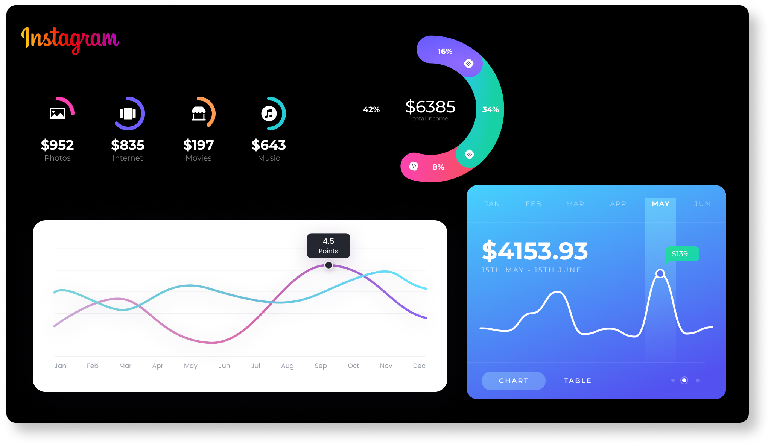
Instagram user analytics
User analysis involves tracking how users engage with a digital product, such as a software application or a mobile app. The insights derived from this analysis can be used by various teams within the business. For example, the marketing team might use these insights to launch a new campaign, the product team might use them to decide on new features to build, and the development team might use them to improve the overall user experience.

Slide 11
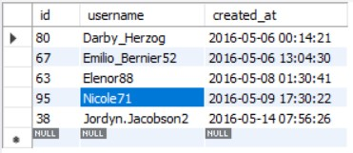
Loyal User Reward: The marketing team wants to reward the most loyal users, i.e., those who have been using the platform for the longest time.
SQL QUERY:
USE ig_clone;
SELECT * FROM users
ORDER BY created_at
LIMIT 5
(The rows are sorted by the ascending order of the time the account is created and the top 5 users are taken)

Slide 12
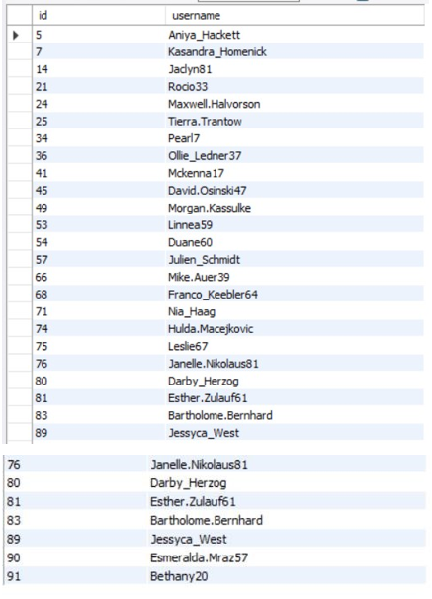
Inactive User Engagement: The team wants to encourage inactive users to start posting by sending them promotional emails.
SQL QUERY:
USE ig_clone;
SELECT U.id, U.username FROM users U
LEFT JOIN photos P
ON U.id = P.user_id WHERE P.user_id IS NULL
(The users table and the photos table are joined using left join and the null values are selected)

Slide 13
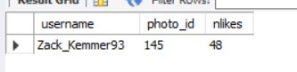
Contest Winner Declaration: The team has organized a contest where the user with the most likes on a single photo wins.
SQL QUERY:
USE ig_clone;
SELECT users.username, likes.photo_id, COUNT(likes.user_id) AS nlikes FROM likes
JOIN photos
ON photos.id = likes.photo_id
JOIN users
ON photos.user_id = users.id
GROUP BY photo_id
ORDER BY nlikes DESC
LIMIT 1
(The likes, users, photos tables are joined and the number of users liked a photo is grouped and the user who posted the photo with the highest number of likes is selected as the winner)

Slide 14
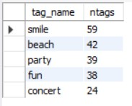
Hashtag Research: A partner brand wants to know the most popular hashtags to use in their posts to reach the most people.
SQL QUERY:
USE ig_clone;
SELECT tag_name, COUNT(user_id) AS ntags FROM photo_tags pt
JOIN tags t
ON pt.tag_id = t.id
JOIN photos p
ON pt.photo_id = p.id
JOIN users u
ON p.user_id = u.id
GROUP BY tag_name
ORDER BY ntags DESC
LIMIT 5
(The photo tags, photos, tags and users tables are joined the togs used by the most users are grouped and sorted in descending order and top 5 are selected)

Slide 15
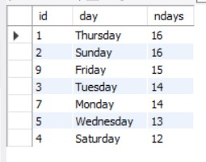
Ad Campaign Launch: The team wants to know the best day of the week to launch ads.
SQL QUERY:
USE ig_clone;
SELECT id, DAYNAME(created_at) AS day, COUNT(id) AS ndays
FROM users
GROUP BY day ORDER BY ndays DESC
(The created_at column is modified to the day of that date and then grouped by the number of times the day occurred)

Slide 16
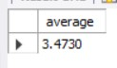
User Engagement: Investors want to know if users are still active and posting on Instagram or if they are making fewer posts. Your Task: Calculate the average number of posts per user on Instagram. Also, provide the total number of photos on Instagram divided by the total number of users.
SQL QUERY1:
USE ig_clone;
SELECT COUNT(photos.id)/COUNT(DISTINCT photos.user_id) AS average
FROM photos
(The number of photos divided by number of users who posted those photos gives the average number of photos posted by users)

Slide 17
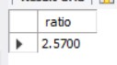
Bots & Fake Accounts: Investors want to know if the platform is crowded with fake and dummy accounts. Your Task: Identify users (potential bots) who have liked every single photo on the site, as this is not typically possible for a normal user.
SQL QUERY2:
USE ig_clone;
SELECT COUNT(DISTINCT photos.id)/COUNT(DISTINCT users.id) AS ratio
FROM users , photos
(The ratio of total number of photos and total number of users is taken)

Slide 18
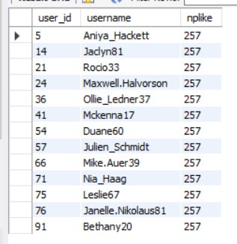
Bots & Fake Accounts: Investors want to know if the platform is crowded with fake and dummy accounts. Your Task: Identify users (potential bots) who have liked every single photo on the site, as this is not typically possible for a normal user.
SQL QUERY:
USE ig_clone;
SELECT likes.user_id, users.username, COUNT(likes.photo_id) AS nplike
FROM likes
JOIN users
ON likes.user_id = users.id
GROUP BY user_id
HAVING nplike = (SELECT COUNT(id) FROM photos)
(The likes and users tables are joined and the uses are grouped by the number of likes they made and the users who have liked total number of photos posted are considered as fake accounts)

Slide 19
Operation and metric analytics

Slide 20
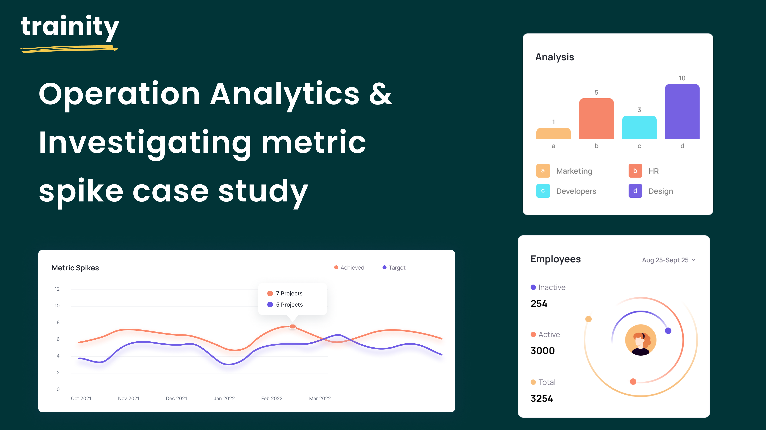
Operation Analytics and Investigating Metric Spike
Operational Analytics is a crucial process that involves analyzing a company's end-to-end operations. This analysis helps identify areas for improvement within the company. As a Data Analyst, you'll work closely with various teams, such as operations, support, and marketing, helping them derive valuable insights from the data they collect. One of the key aspects of Operational Analytics is investigating metric spikes. This involves understanding and explaining sudden changes in key metrics, such as a dip in daily user engagement or a drop in sales. As a Data Analyst, you'll need to answer these questions daily, making it crucial to understand how to investigate these metric spikes.

Slide 21
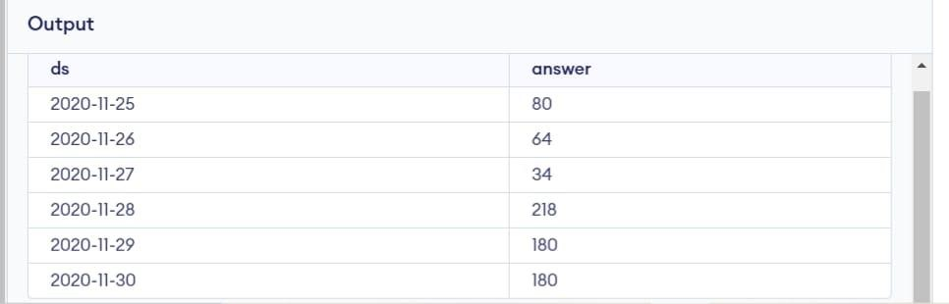
Jobs Reviewed Over Time: Calculate the number of jobs reviewed per hour for each day in November 2020.
To calculate number of jobs reviewed per hour per each day of November 2020 Query:
select ds, (count(distinct job_id)*3600)/(sum(time_spent)*count(distinct ds)) as answer from table1
group by ds

Slide 22
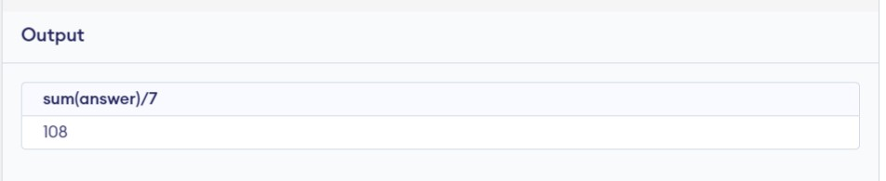
Throughput Analysis:Calculate the 7-day rolling average of throughput (number of events per second).
Query: select sum(answer)/7 from( select ds, (count(distinct job_id)*3600)/(sum(time_spent)*count(distinct ds)) as answer from table1 group by ds
)
For throughput it is better to use daily metric rather than 7-day rolling as the values are not closer to each other.

Slide 23
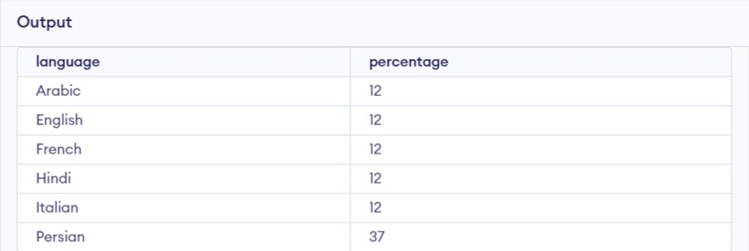
Language Share Analysis: Calculate the percentage share of each language in the last 30 days.
Query:
select language, count(language)*100/(select count(language) from table1) as percentage from table1 group by language

Slide 24
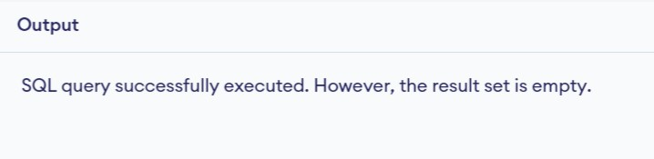
Duplicate Rows Detection: Identify duplicate rows in the data.
Query:
select ds, job_id, actor_id, event, language, time_spent, org, count(actor_id) from table1 group by actor_id, job_id, ds, event, language, time_spent, org having count(actor_id)>1

Slide 25
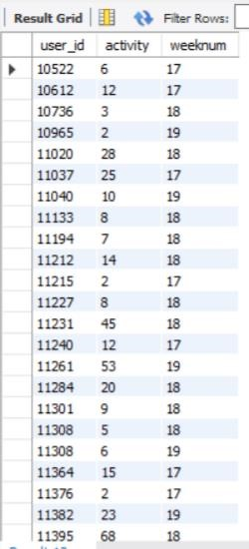
Weekly User Engagement: Measure the activeness of users on a weekly basis.
Query:
SELECT user_id, count(occurred_at), weeknum
FROM (select user_id, occurred_at, week(occurred_at) as weeknum from events where event_type = 'engagement') ot GROUP BY user_id, weeknum;

Slide 26
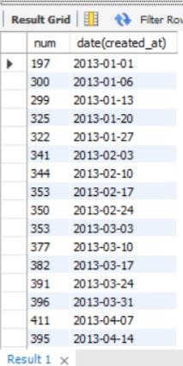
User Growth Analysis: Analyze the growth of users over time for a product.
Query: select count(user_id) as num, date(created_at) from users group by week(date(created_at));

Slide 27
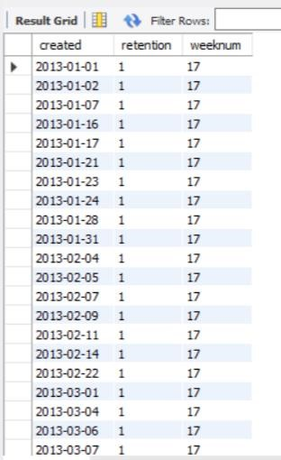
Weekly Retention: Users getting retained weekly after signing-up for a product.
Query:
select created, count(distinct u1) as retention, week(occurred) as weeknum from( select date(occurred_at) as occurred, u1, u2, date(created_at) as created from
(select user_id as u1, occurred_at, event_name from events
where event_type='engagement' order by user_id)t1 left join (select user_id as u2, created_at from users where state='active')t2
on t1.u1=t2.u2 group by occurred, created )t3 group by week(occurred), created

Slide 28
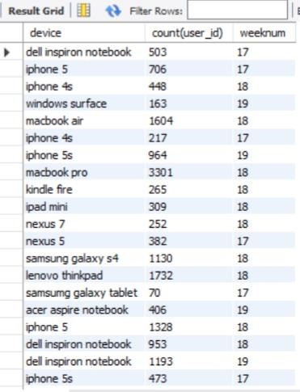
Weekly Engagement: To measure the activeness of a user. Measuring if the user finds quality in a product/service weekly.
Query:
SELECT device, count(user_id), weeknum
FROM (select user_id, week(occurred_at) as weeknum, device from events where event_type = 'engagement') ot
GROUP BY device, weeknum;

Slide 29
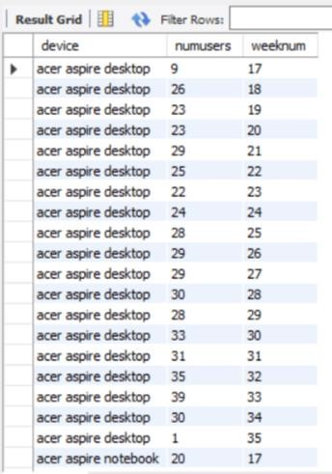
to calculate the total number of distinct users that use a particular type of device in a week
Query:
SELECT device, count( distinct user_id) as numusers, weeknum
FROM (select user_id, week(occurred_at) as weeknum, device from events where event_type = 'engagement') ot
GROUP BY device, weeknum;

Slide 30
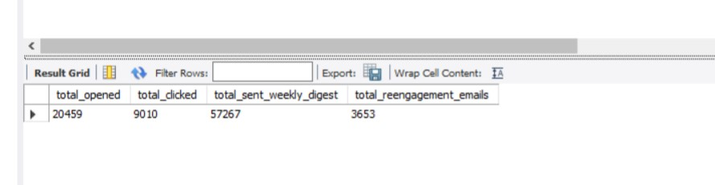
Email Engagement Analysis: Analyze how users are engaging with the email service.
Query:
SELECT
SUM(CASE WHEN action = 'email_open' THEN 1 ELSE 0 END) AS total_opened,
SUM(CASE WHEN action = 'email_clickthrough' THEN 1 ELSE 0 END) AS total_clicked,
SUM(CASE WHEN action = 'sent_weekly_digest' THEN 1 ELSE 0 END) AS total_sent_weekly_digest,
SUM(CASE WHEN action = 'sent_reengagement_email' THEN 1 ELSE 0 END) AS total_reengagement_emails
FROM email_events;

Slide 31
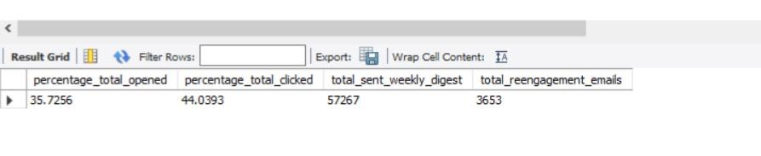
To calculate the total number of weekly digests sent, re-engagement emails sent, percentage of emails opened, percentage of emails clicked through after opening.
Query:
SELECT
(SUM(CASE WHEN action = 'email_open' THEN 1 ELSE 0 END)/SUM(CASE WHEN action = 'sent_weekly_digest' THEN 1 ELSE 0 END)*100 )AS percentage_total_opened,
(SUM(CASE WHEN action = 'email_clickthrough' THEN 1 ELSE 0 END)/SUM(CASE
WHEN action = 'email_open' THEN 1 ELSE 0 END)*100) AS percentage_total_clicked,
SUM(CASE WHEN action = 'sent_weekly_digest' THEN 1 ELSE 0 END) AS total_sent_weekly_digest,
SUM(CASE WHEN action = 'sent_reengagement_email' THEN 1 ELSE 0 END) AS total_reengagement_emails
FROM
email_events;

Slide 32
Hiring process analytics

Slide 33
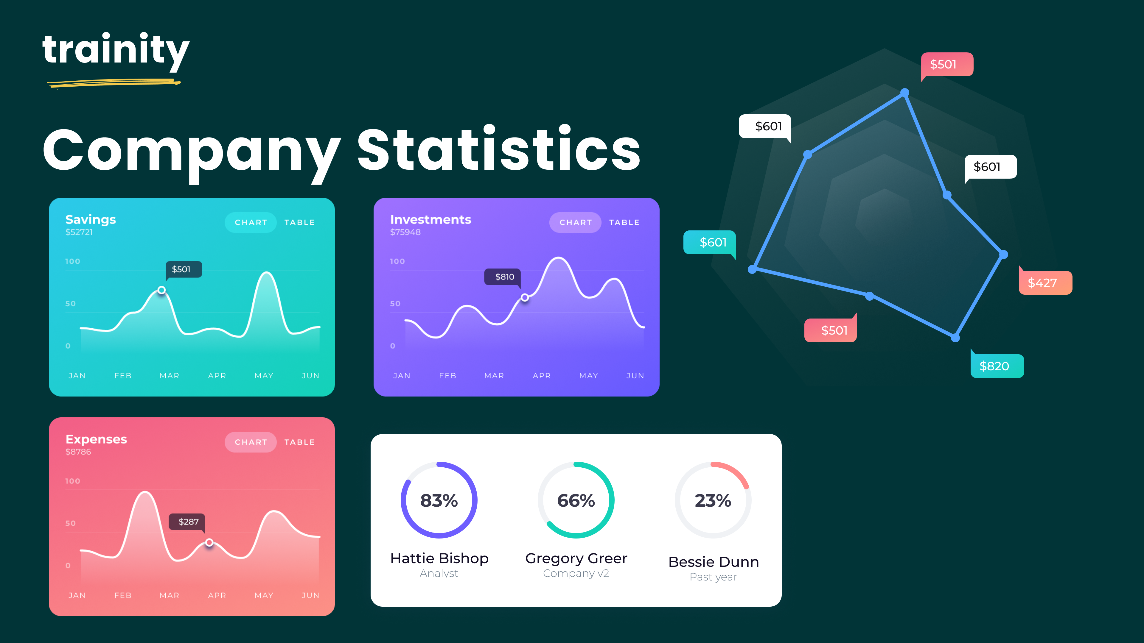
Hiring process analytics
The hiring process is a crucial function of any company, and understanding trends such as the number of rejections, interviews, job types, and vacancies can provide valuable insights for the hiring department.

Slide 34
Outliers
Perform EDA before using the data for the analysis.
Remove the empty cells in the sheet.
Delete the outliers • Find the outliers in the data using the quartile function
First quartile Q1[=QUARTILE.EXC(G2:G7169,1)] has the value 25454
Third quartile Q3 [=QUARTILE.EXC(G2:G7169,3)] has the value 74456
The interquartile range (IQR) = 49002
Upper limit = Q3+1.5*IQR = 147959
Lower limit = Q1-1.5*IQR = -48049
Outliers are the values which are greater than the upper limit or less than the lower limit.

Slide 35
analysis using pivot tables
Row Labels | Count of Offered Salary
800-10799 | 738
10800- 20799 | 709
20800- 30799 | 724
30800- 40799 | 717
40800- 50799 | 767
50800- 60799 | 760
60800- 70799 | 693
70800- 80799 | 744
80800- 90799 | 692
90800- 100799 | 604
Grand Total | 7148
Count of event_name | Column Labels
Row Labels | Hired | Rejected | Grand Total
Don’t want to say | 268 | 125 | 393
Female | 1854 | 819 | 2673
Male | 2561 | 1521 | 4082
Grand Total | 4683 | 2465 | 7148
males and females are Hired
class intervals for salary in the company

Slide 36

Analysis using various graphs
proportion of people working different department
TOTAL
60000
50821.31034
48839.24858
51244.35931
49937.95455
50000
49281.95662
50190.24627
50202.4676
49512.14904
49777.69356
Total
44841.95402
44700
46219
288
,
4
%
170
41402
,
2
%
97
,
1
%
Finance Department
40000
324
,
5
%
34521.33333
General Management
30000
26990
Total
2047
,
29
%
Human Resource
Department
20000
2767
Marketing Department
744
,
39
%
,
10
%
Operations Department
10000
332
Production Department
,
5
%
379
0
,
5
%
B9
C
-
10
C5
C8
C9
I1
I4
I5
I6
I7
M6
M7
N10
N6
N9

Slide 37
IMDB Movie analysis

Slide 38
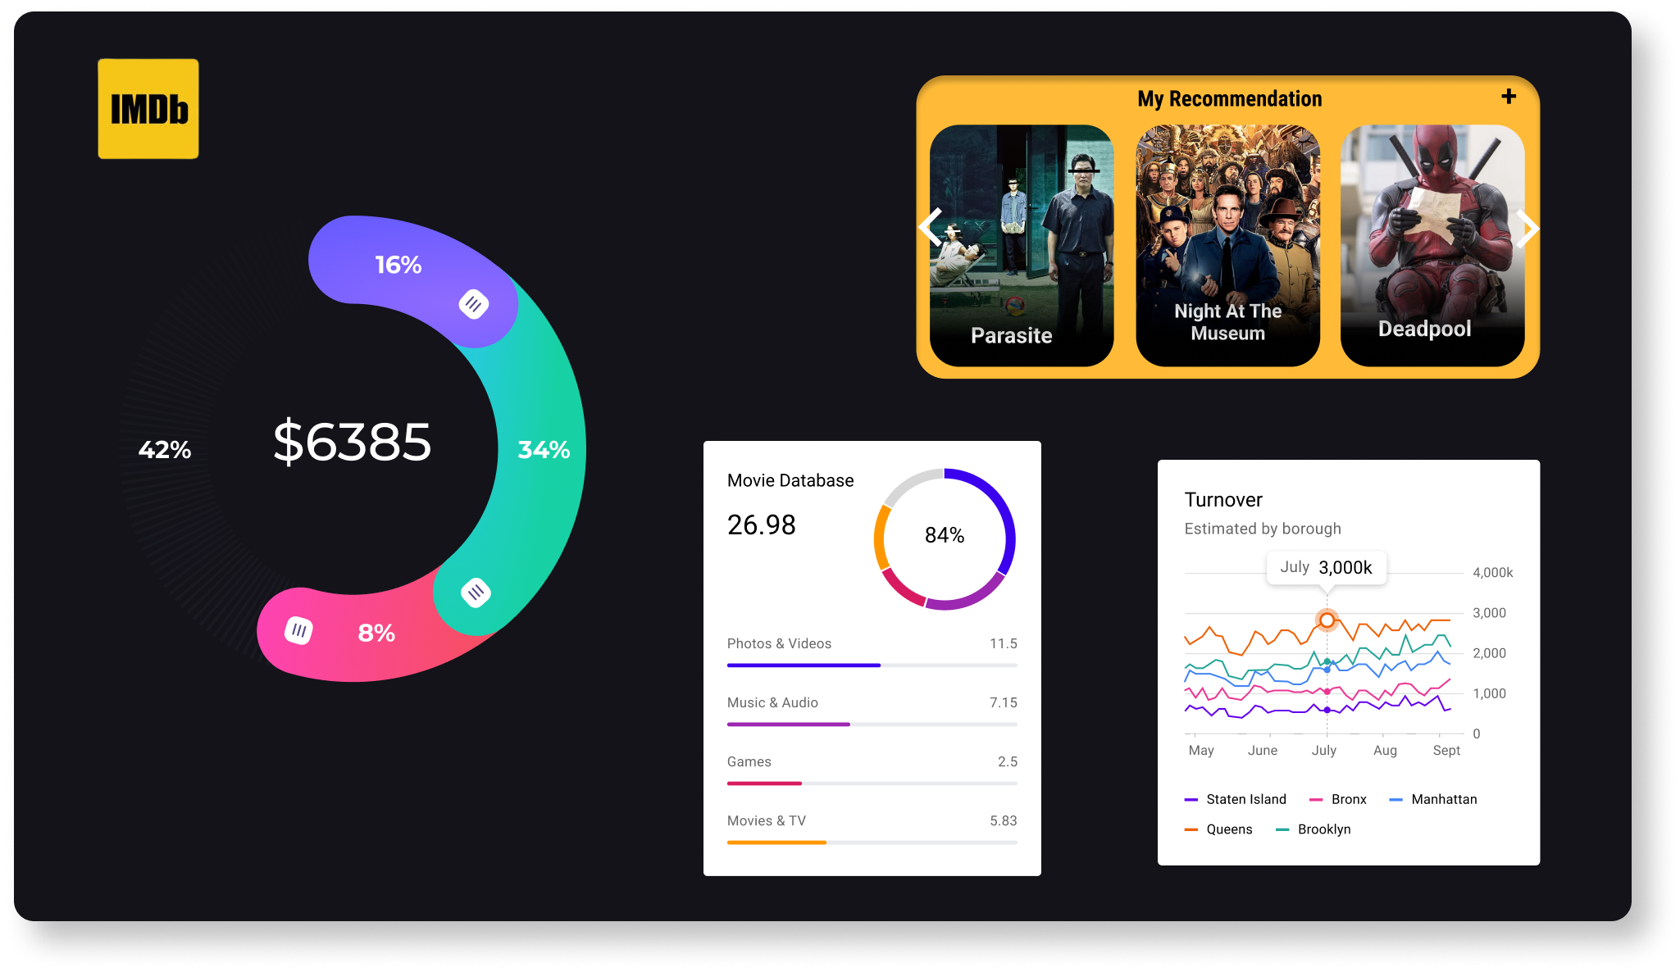
IMDB movie analysis
A potential problem to investigate could be: "What factors influence the success of a movie on IMDB?" Here, success can be defined by high IMDB ratings. The impact of this problem is significant for movie producers, directors, and investors who want to understand what makes a movie successful to make informed decisions in their future projects.

Slide 40
Row Labels | Average of imdb_score
Akira Kurosawa | 8.7
Tony Kaye | 8.6
Charles Chaplin | 8.6
Alfred Hitchcock | 8.5
Ron Fricke | 8.5
Majid Majidi | 8.5
Damien Chazelle | 8.5
Sergio Leone | 8.433333333
Christopher Nolan | 8.425
Asghar Farhadi | 8.4
Richard Marquand | 8.4
Grand Total | 8.47
Row Labels | Count of genre
Drama | 1896
Comedy | 1462
Thriller | 1116
Action | 961
Romance | 859
Adventure | 785
Crime | 708
Fantasy | 509
Sci-Fi | 497
Family | 443
Horror | 392
Mystery | 385
Biography | 240
Animation | 197
Music | 152
War | 150
Sport | 148
History | 148
Musical | 96
Western | 59
Documentary | 45
Film-Noir | 1
Grand Total | 11249
top 10 directors for whom the mean of imdb_score is the highest
popular genres

Slide 41
Row Labels | Average of num_user_for_reviews | Average of num_critic_for_reviews
Albert Finney | 1498 | 750
Phaldut Sharma | 1885 | 738
Row Labels | Average of num_user_for_reviews | Average of num_critic_for_reviews
Heather Donahue | 3400 | 360
Christo Jivkov | 2814 | 406
Steve Bastoni | 2789 | 275
Critic favourite
Audience favourite

Slide 42
Bank loan case study

Slide 43
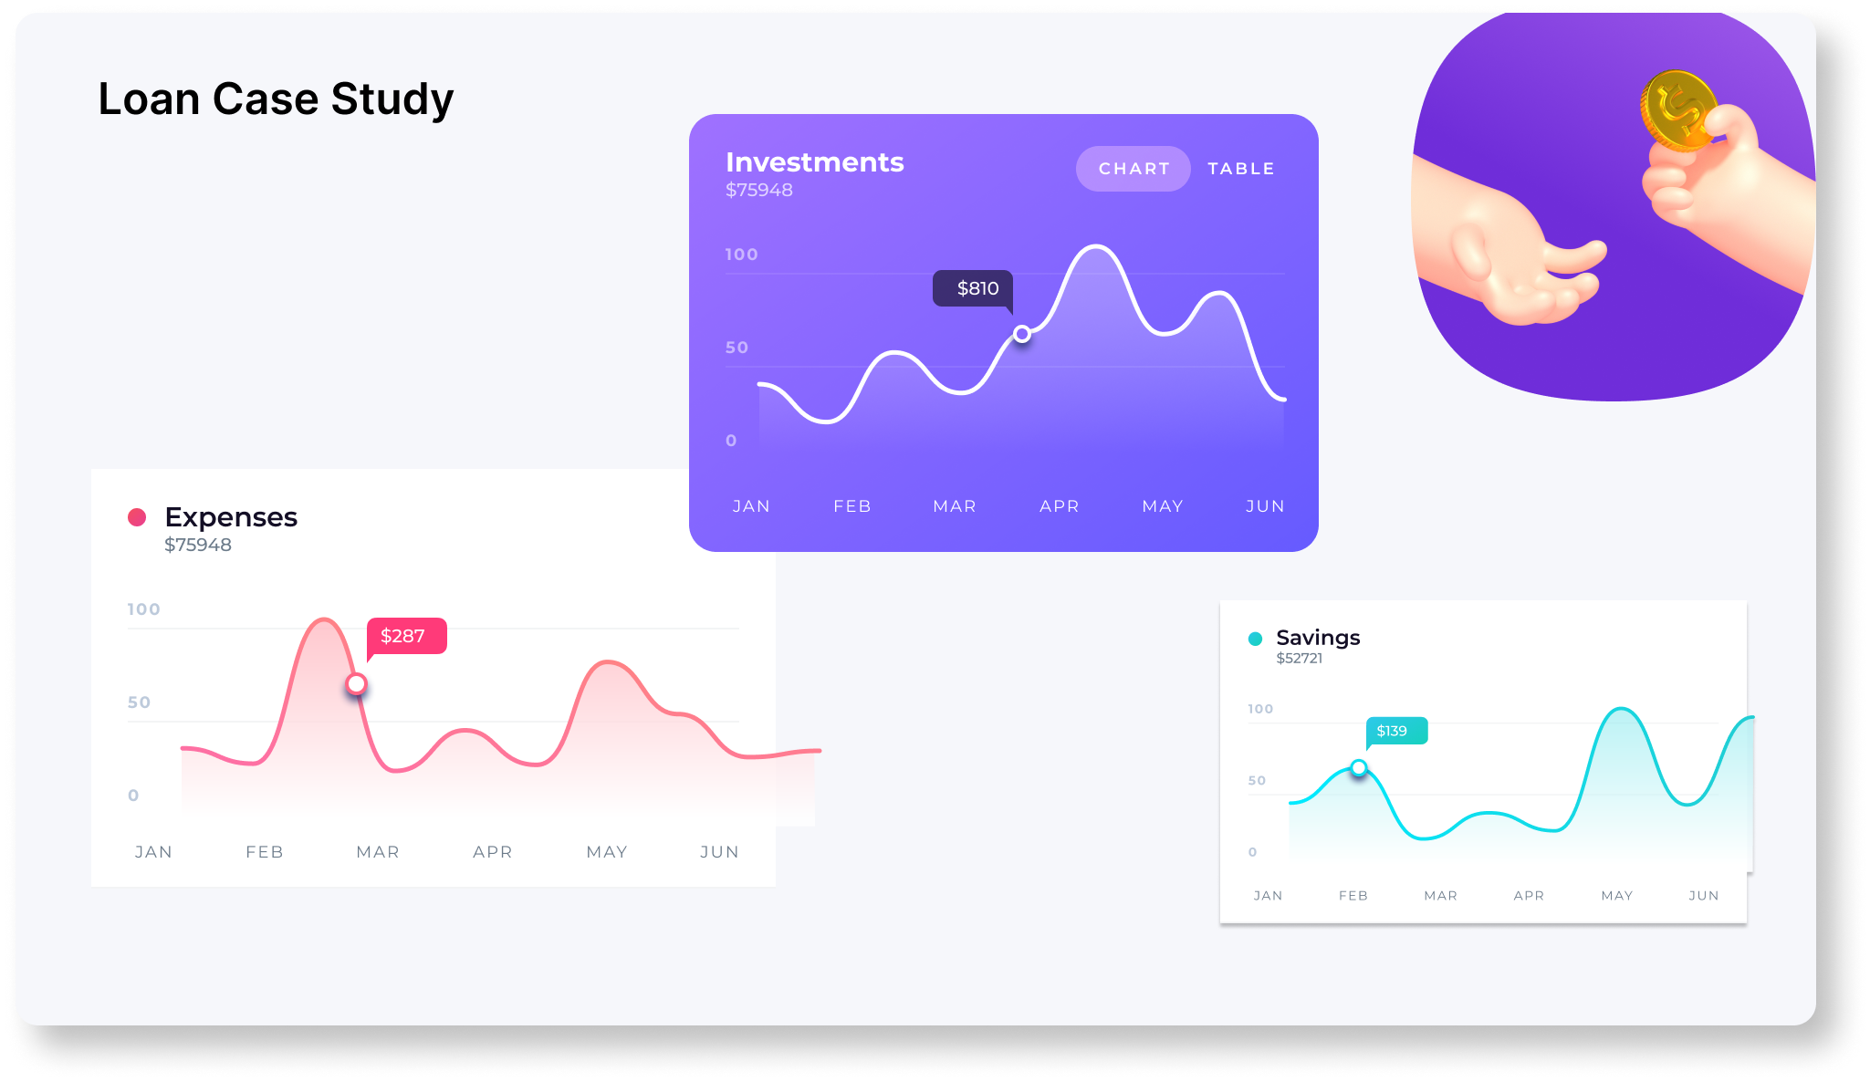
Loan case study
A finance company that specializes in lending various types of loans to urban customers faces a challenge: some customers who don't have a sufficient credit history take advantage of this and default on their loans.
Use Exploratory Data Analysis (EDA) to analyze patterns in the data and ensure that capable applicants are not rejected.

Slide 44
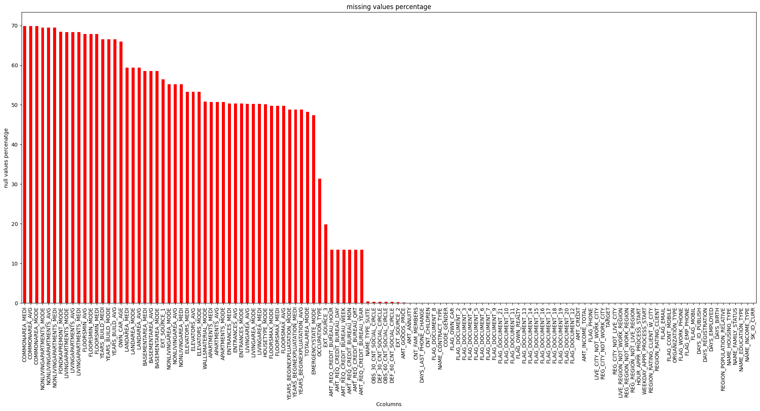
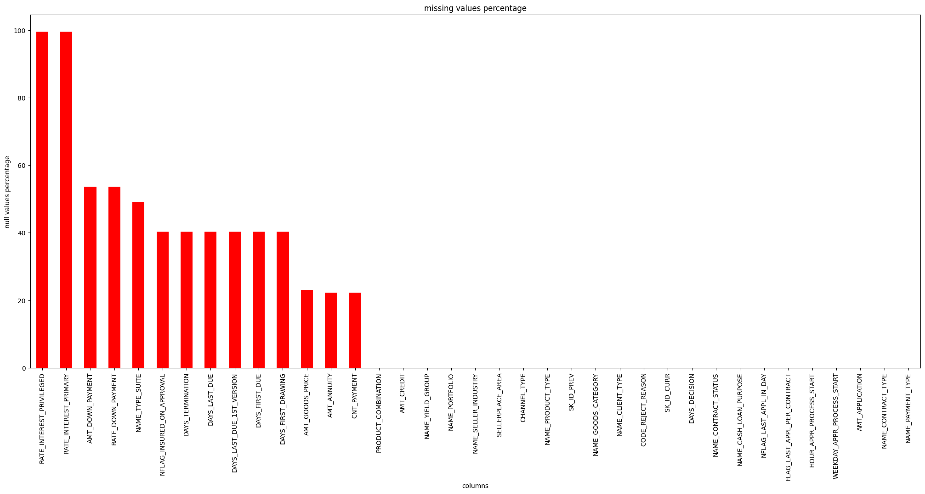
Percentage of missing values

Slide 45
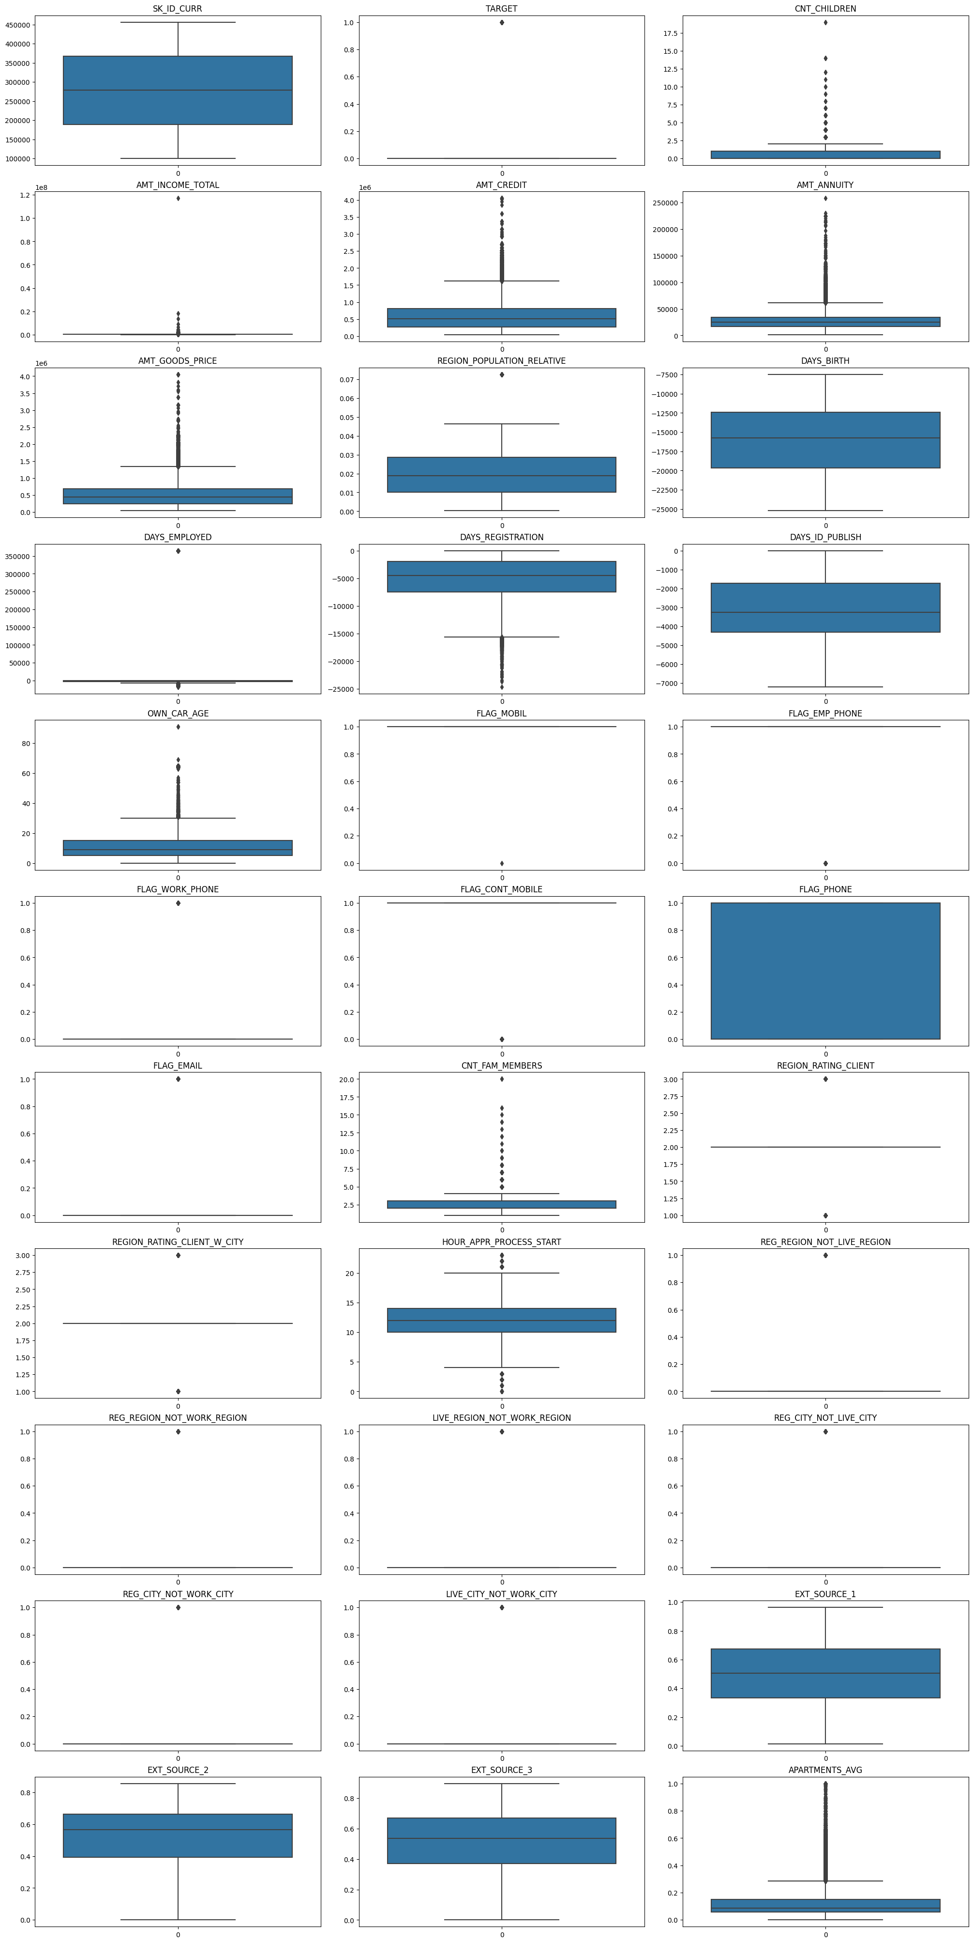
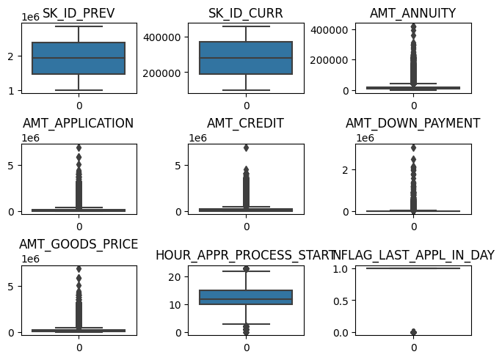
outliers

Slide 46
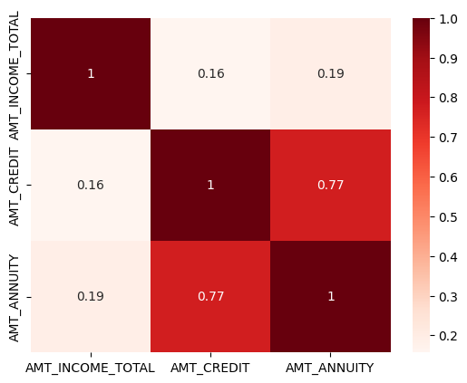
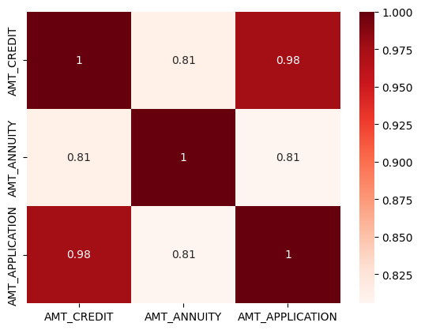
Heatmaps for correlation coefficients

Slide 47
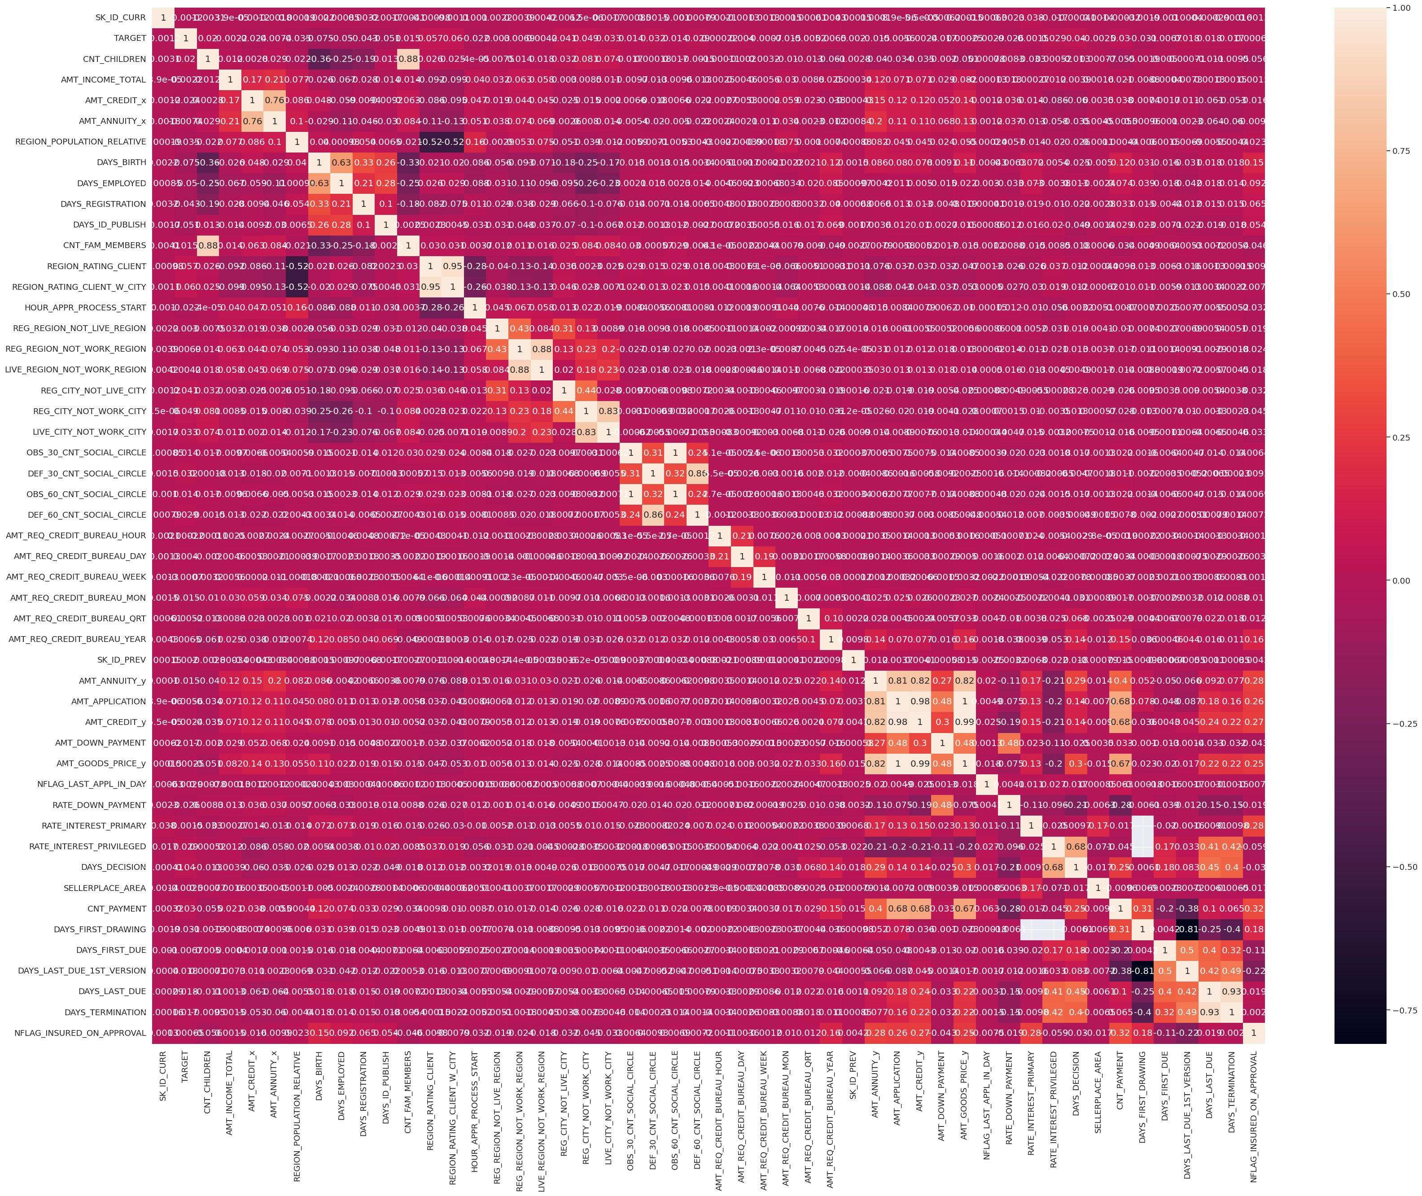

Slide 48
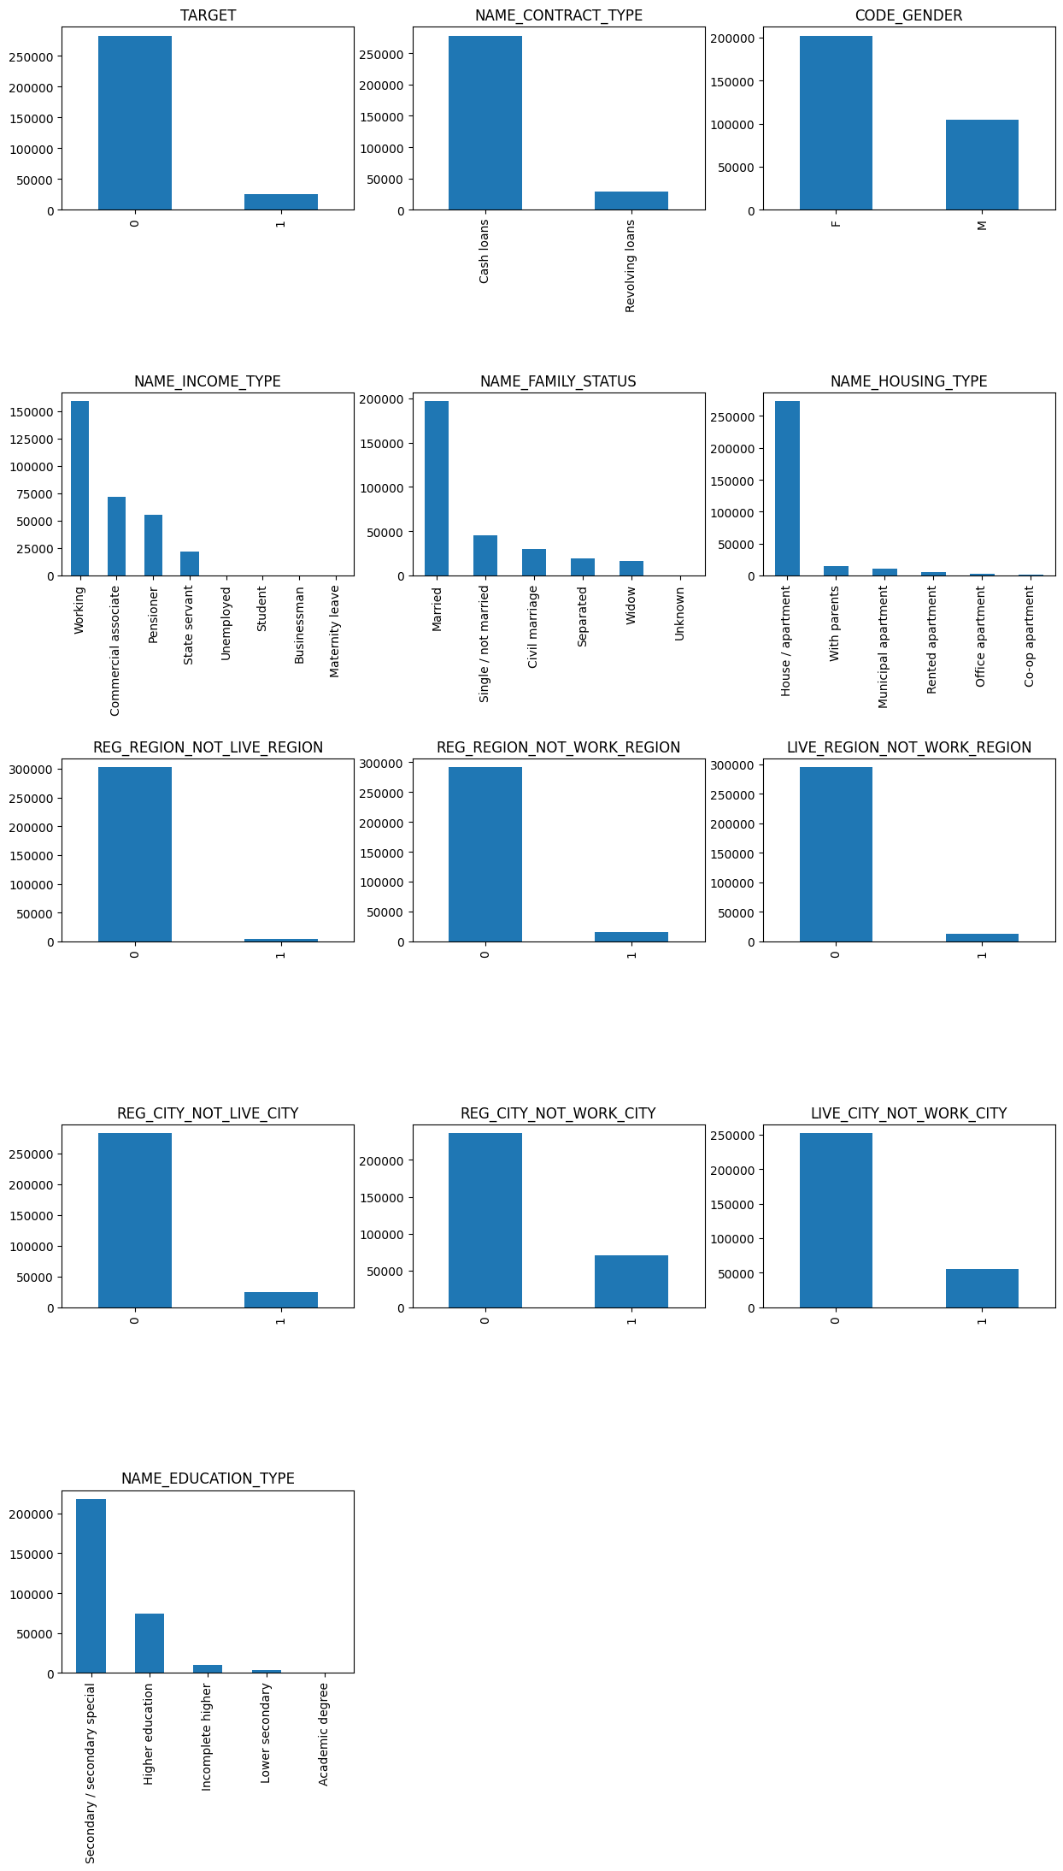
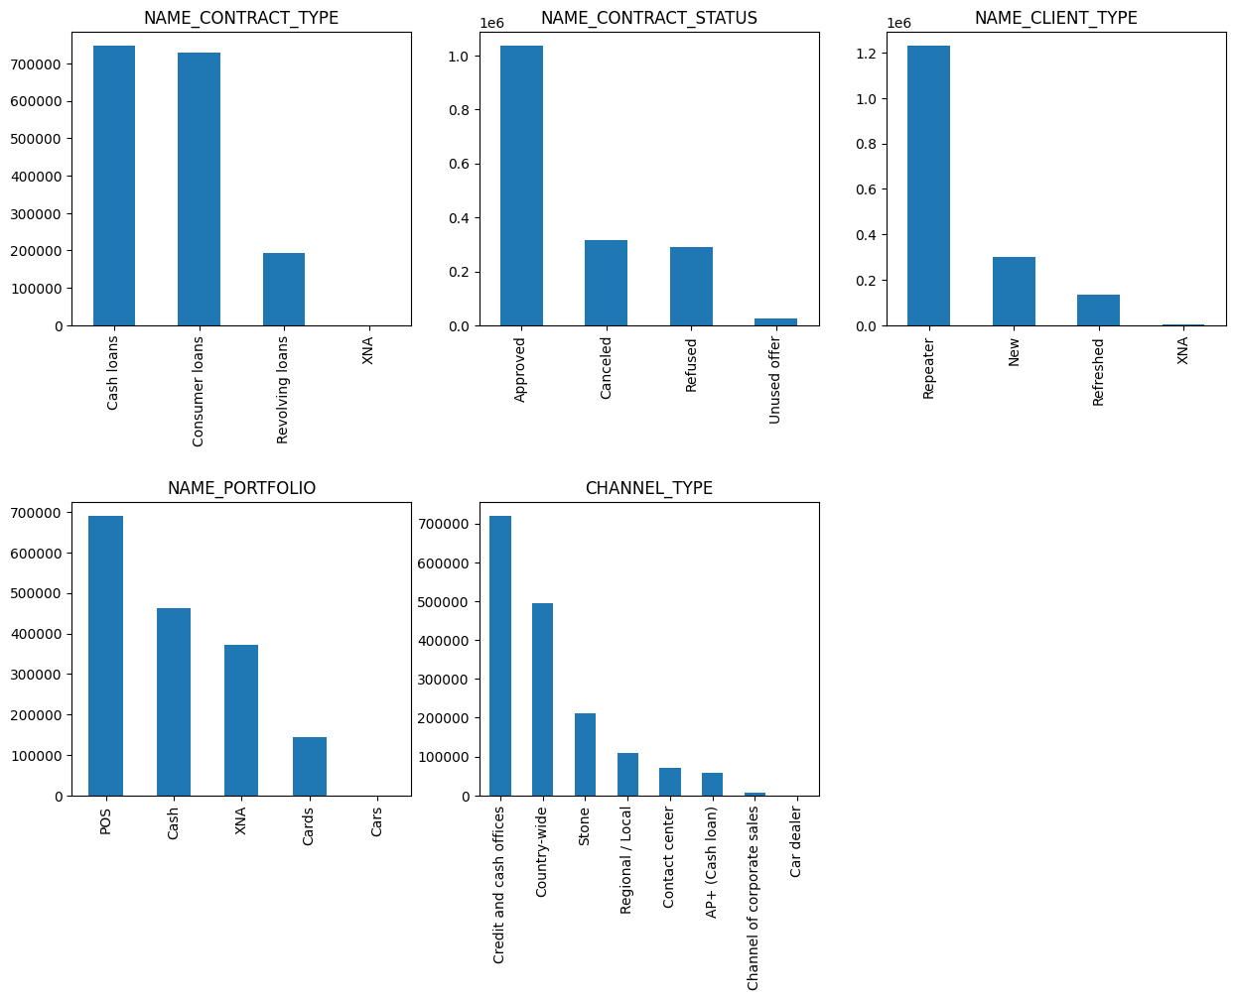
Data imbalance

Slide 49
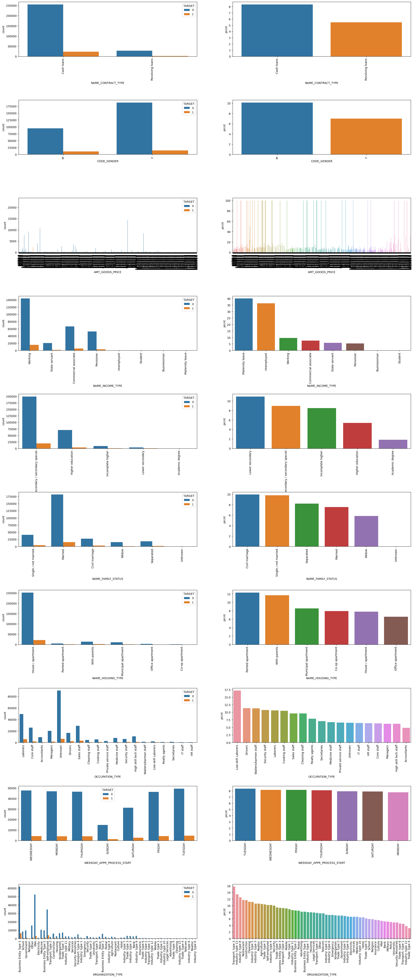
Univariate analysis
Univariate analysis involves the examination of a single variable at a time. It focuses on describing and summarizing the distribution of values within that variable.
The main goal is to understand the characteristics of a single variable, such as central tendency, dispersion, and shape of the distribution.

Slide 50
People who have cash loans are less likely to be defaulters.
Females are less likely to be defaulters compared to males as when compared many females are regulars.
Working professionals are very less likely to default compared to others as we have more data on them and the graphs indicate.
Commercial Associate, pensioner and state servant are less likely to be defaulters.
Secondary/Secondary Special are very less likely to be defaulters.
People with higher education are less likely to be defaulters.
Married people are very less likely to default. And they are the ones who took the most loans compared to others.
People who own a house or an apartment are very less likely to be defaulters.
People in business entity type 3 and XNA are very less likely to be defaulters.
People who are self employed are less likely to be defaulters.

Slide 51
Segmented univariate analysis
Segmented univariate analysis is an extension of univariate analysis where the data is divided into subgroups or segments based on another variable, and then univariate analysis is performed on each segment.
This type of analysis helps in understanding how the distribution of a variable varies across different segments. It allows for a more nuanced exploration of the data, revealing potential patterns or differences that may not be apparent in a global univariate analysis.

Slide 52
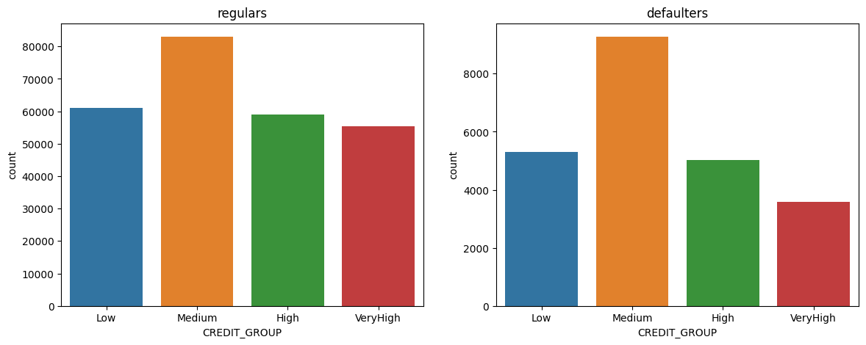
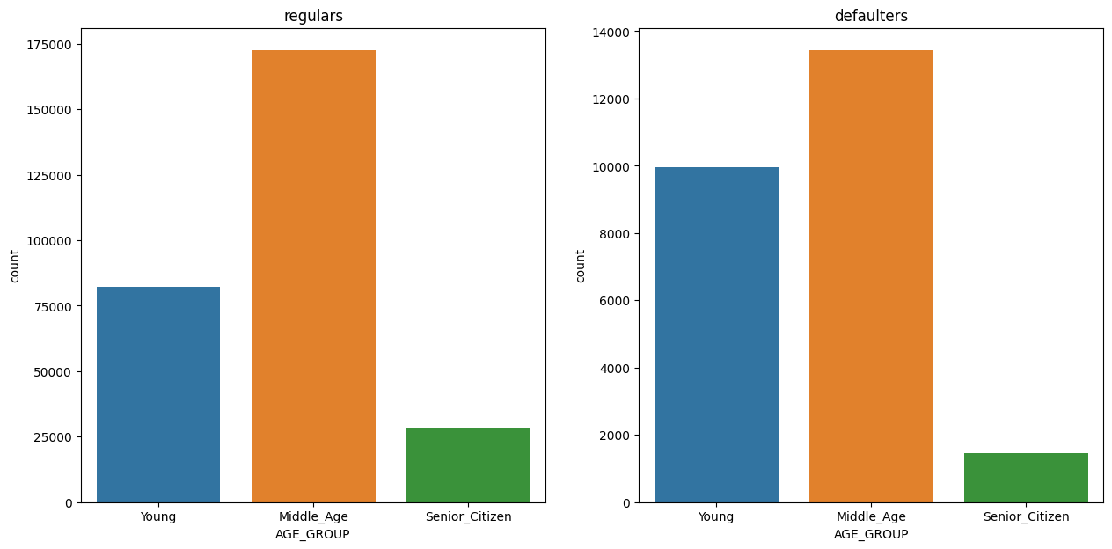
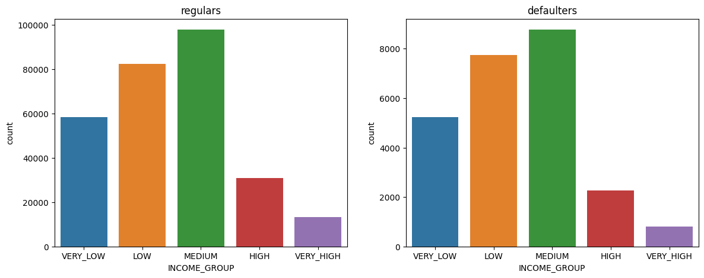

Slide 53
Middle aged people and senior citizens are less likely to be defaulters compared to young people.
In case of CREDIT_GROUP it is hard to predict as all groups are almost same in comparison of defaulters and regulars. But we can say people with very high income are less likely to be defaulters.
In case of INCOME_GROUP also it is hard to predict as the ratios are similar.

Slide 54
Bivariate analysis
Bivariate analysis involves the simultaneous analysis of two variables to determine if there is a relationship or association between them.
The main goal is to explore how changes in one variable are related to changes in another.

Slide 55
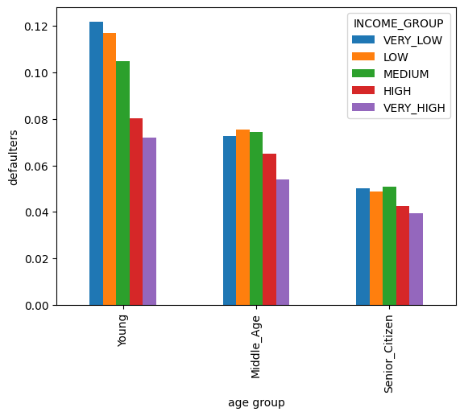
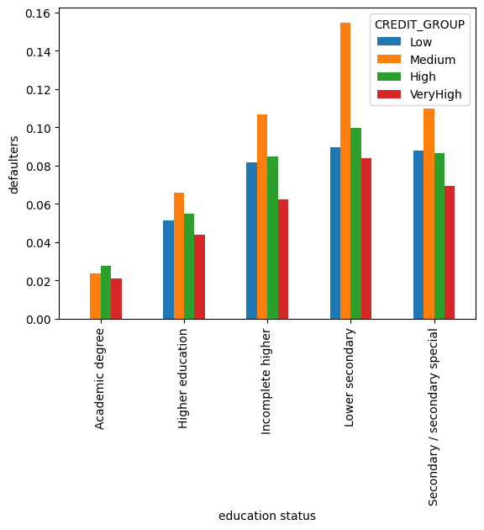

Slide 56
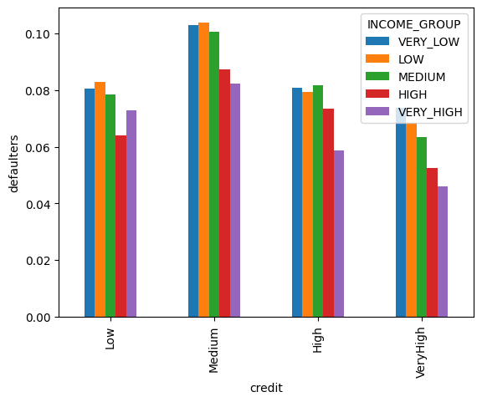
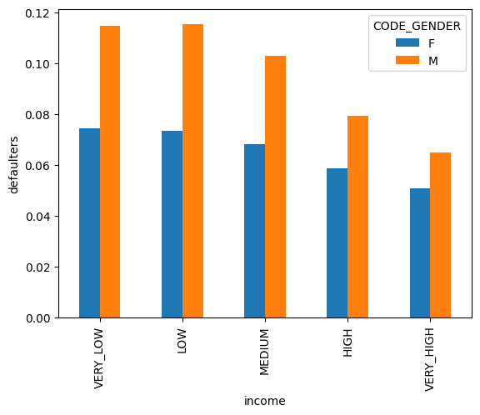

Slide 57
People who are young and have low income are more likely to be defaulters.
People who have lower secondary education and medium credit are likely to be defaulters.
People who have incomplete higher education or secondary or secondary special education and in medium credit group are also likely to be defaulters.
People who are medium credit group and medium income are a bit likely to be defaulters. – it is hard to predict from the graph though.
Males with low and very low income are more likely to be defaulters.

Slide 58
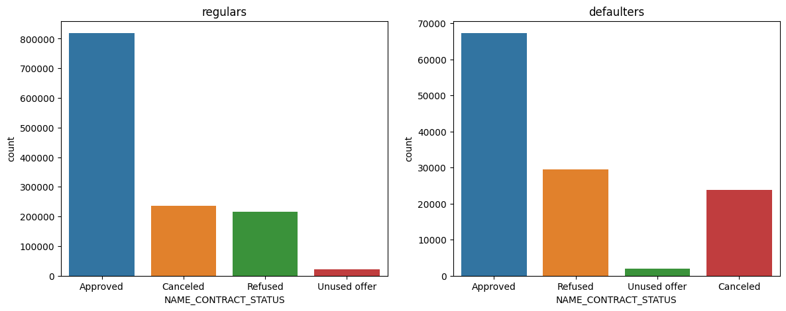
Univariate analysis of merged datasets

Slide 59
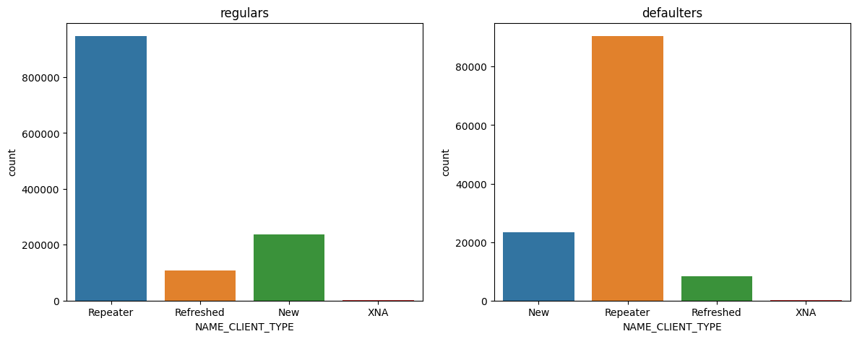
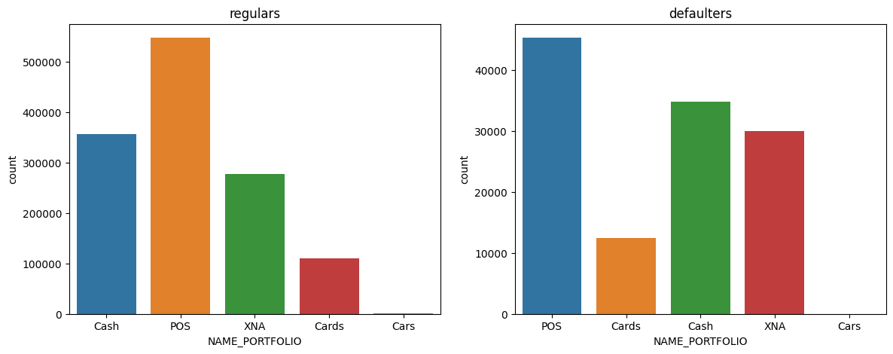

Slide 60
People with approved contract status are high in both defaulters and non-defaulters. – it is hard to predict from the graph.
Repeaters are more likely to be defaulters.
People with POS as the name portfolio are more likely to be defaulters.

Slide 61
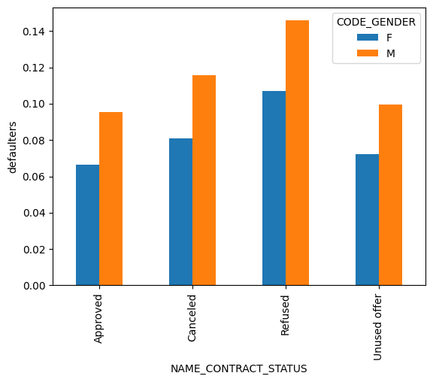
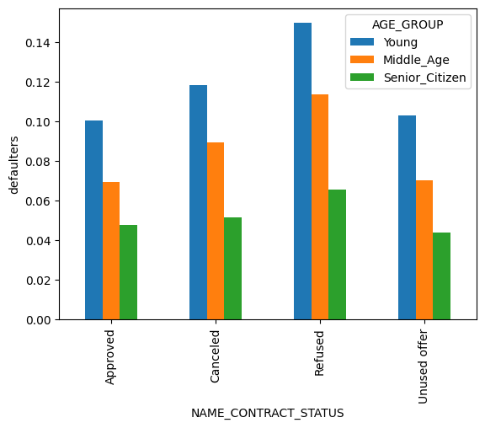
Bivariate analysis of merged dataframe

Slide 62
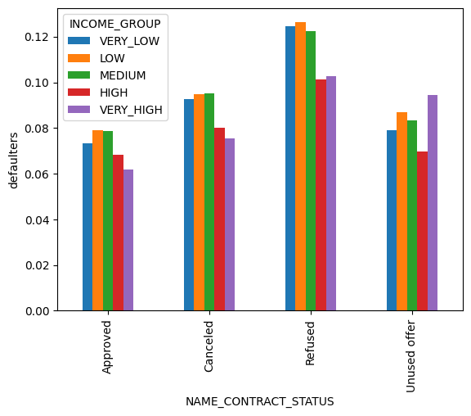
Males are more likely to be defaulters and to be refused.
Young people are more likely to be defaulters and to be refused.
People with low and very low income are likely to be defaulters and to be refused.

Slide 63
Impact of car features

Slide 64
Analyzing the impact of car features on price and profitability
The automotive industry has been rapidly evolving over the past few decades, with a growing focus on fuel efficiency, environmental sustainability, and technological innovation. With increasing competition among manufacturers and a changing consumer landscape, it has become more important than ever to understand the factors that drive consumer demand for cars. In recent years, there has been a growing trend towards electric and hybrid vehicles and increased interest in alternative fuel sources such as hydrogen and natural gas. At the same time, traditional gasoline-powered cars remain dominant in the market, with varying fuel types and grades available to consumers.
analyzing the relationship between a car's features, market category, and pricing, and identifying which features and categories are most popular among consumers and most profitable for the manufacturer. By using data analysis techniques such as regression analysis and market segmentation, the manufacturer could develop a pricing strategy that balances consumer demand with profitability, and identify which product features to focus on in future product development efforts. This could help the manufacturer improve its competitiveness in the market and increase its profitability over time.

Slide 65
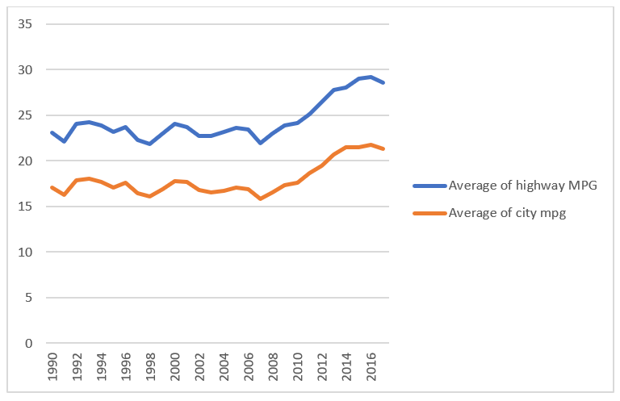
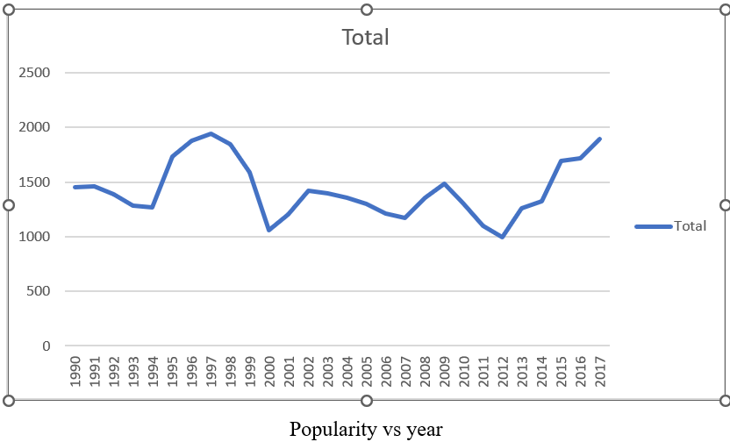
Analyzing the trends over years

Slide 66
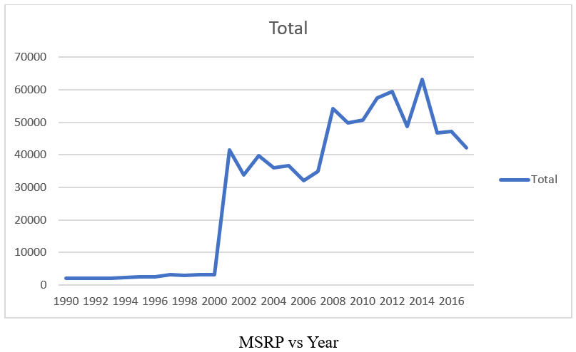

Analyzing the MSRP for features of the car

Slide 67


Analyzing the relation between engine HP and other features

Slide 68
Popularity vs various features of the car

Slide 70
MSRP | Column1
0.531312 | engine cylinders
-0.12664 | number of doors
0.662008 | engine HP
-0.16004 | highway MPG
-0.15768 | city MPG
Based on the car features and brand the car prices differ a lot. For example famous brands like Bugatti have high costs. Other than the brand the style, model, speed and flexibility of the car also effect the price considerably.
From the graphs we can observe that engine HP has a significant impact on the price. For high engine HP the prices increased.
We can also see that the popularity of the cars is increasing over time.
The MSRP of the vehicles is also increasing over time.
It means more people are willing to spend on vehicles and their popularity is increasing over time.
The manufacturers should focus more on the cars that are popular among people and try to increase their flexibility and features and develop new models in them.
For the remaining cars also it is better to make them more flexible and add more versions or features so that people will prefer them and the diversity will be maintained.

Slide 71
ABC call volume trend

Slide 72
Customer experience analysis
A Customer Experience (CX) team plays a crucial role in a company. They analyze customer feedback and data, derive insights from it, and share these insights with the rest of the organization. This team is responsible for a wide range of tasks, including managing customer experience programs, handling internal communications, mapping customer journeys, and managing customer data, among others. In the current era, several AI-powered tools are being used to enhance customer experience. These include Interactive Voice Response (IVR), Robotic Process Automation (RPA), Predictive Analytics, and Intelligent Routing. One of the key roles in a CX team is that of the customer service representative, also known as a call center agent. These agents handle various types of support, including email, inbound, outbound, and social media support. Inbound customer support, which is the focus of this project, involves handling incoming calls from existing or prospective customers. The goal is to attract, engage, and delight customers, turning them into loyal advocates for the business.

Slide 73
Row Labels | Average of Call_Seconds (s)
10_11 | 209.146173
11_12 | 203.3522837
12_13 | 190.7582262
13_14 | 193.5996208
14_15 | 193.196702
15_16 | 195.4858855
16_17 | 196.542932
17_18 | 198.7127846
18_19 | 201.0931383
19_20 | 203.9389068
20_21 | 202.5537849
9_10 | 199.0057078
Grand Total | 197.7097159

Slide 74
Row Labels | Count of Customer_Phone_No
10_11 | 13313
11_12 | 14626
12_13 | 12652
13_14 | 11561
14_15 | 10561
15_16 | 9159
16_17 | 8788
17_18 | 8534
18_19 | 7238
19_20 | 6463
20_21 | 5505
9_10 | 9588
Grand Total | 117988

Slide 75


Slide 76

The current rate of abandoned calls is approximately 30%. Propose a plan for manpower allocation during each time bucket (from 9 am to 9 pm) to reduce the abandon rate to 10%. In other words, you need to calculate the minimum number of agents required in each time bucket to ensure that at least 90 out of 100 calls are answered. What is the minimum number of agents required in each time bucket to reduce the abandon rate to 10%?
We have 65 employees
On an average the customers are abandoning the call after being queued for 92 seconds
On an average we get maximum number calls from 11-12 time bucket
Number of calls a single employee can take in an hour =3600/average call duration=18 (approximately)
18*number of employees>no of customer calls

Slide 77
Customers also call ABC Insurance Company at night but don't get an answer because there are no agents available. This creates a poor customer experience. Assume that for every 100 calls that customers make between 9 am and 9 pm, they also make 30 calls at night between 9 pm and 9 am. Propose a manpower plan for each time bucket throughout the day, keeping the maximum abandon rate at 10%.

